Slide 1
Tutorial 4
Scheduling Policies

Slide 2
Scheduler
The scheduler selects from among the processes in ready queue, and allocates a CPU core to one of them
The ready queue may be ordered in various ways
CPU scheduling decisions may take place when a process:
1. Switches from running to waiting state
2. Switches from running to ready state
3. Switches from waiting to ready
4.Terminates
For situations 1 and 4, there is no choice in terms of scheduling. A new process (if one exists in the ready queue) must be selected for execution.
For situations 2 and 3, however, there is a choice.

Slide 3
Preemptive and Nonpreemptive Scheduling
When scheduling takes place only under circumstances 1 and 4, the scheduling scheme is nonpreemptive.
Otherwise, it is preemptive.
Under Nonpreemptive scheduling, once the CPU has been allocated to a process, the process keeps the CPU until it releases it either by terminating or by switching to the waiting state.
What is the potential problem?
Virtually all modern operating systems including Windows, MacOS, Linux, and UNIX use preemptive scheduling algorithms.

Slide 4
Preemptive Scheduling and Race Conditions
Preemptive scheduling can result in race conditions when data are shared among several processes.
Consider the case of two processes that share data. While one process is updating the data, it is preempted so that the second process can run. The second process then tries to read the data, which are in an inconsistent state.

Slide 5
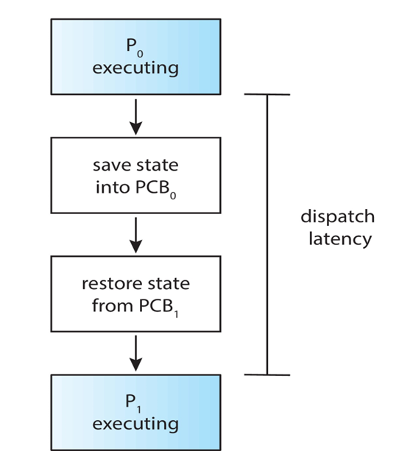
Dispatcher
Dispatcher module gives control of the CPU to the process selected by the CPU scheduler; this involves:
•Switching context
•Switching to user mode
•Jumping to the proper location in the user program to restart that
program
Dispatch latency – time it takes for the dispatcher to stop one process
and start another running

Slide 6
Scheduling Criteria
CPU utilization – keep the CPU as busy as possible
Throughput – # of processes that complete their execution per time unit
Turnaround time – amount of time to execute a particular process
Waiting time – amount of time a process has been waiting in the ready queue
Response time – amount of time it takes from when a request was submitted until the first response is produced.

Slide 7
Optimization Criteria for Scheduling Algorithms
Max CPU utilization
Max throughput
Min turnaround time
Min waiting time
Min response time

Slide 8
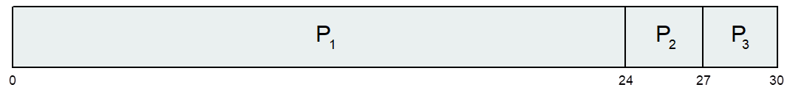
First- Come, First-Served (FCFS) Scheduling
Example with 3 processes
Process Burst Time
P₁ 24
P₂ 3
P₃ 3
Suppose that the processes arrive in the order: P₁ , P₂ , P₃
The Gantt Chart for the above schedule is:
Waiting time for P₁ = 0; P₂ = 24; P₃ = 27
Average waiting time: (0 + 24 + 27)/3 = 17

Slide 9
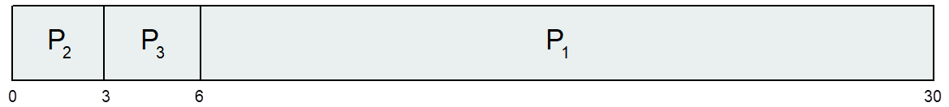
Cont.
Suppose that the processes arrive in the order:
P₂ , P₃ , P₁
The Gantt chart for the schedule is:
Waiting time for P₁ = 6; P₂ = 0 ; P₃ = 3
Average waiting time: (6 + 0 + 3)/3 = 3
Much better than previous case

Slide 10
Shortest-Job-First (SJF) Scheduling
Associate with each process the length of its next CPU burst
•Use these lengths to schedule the process with the shortest time
SJF is optimal – gives minimum average waiting time for a given set of processes

Slide 11
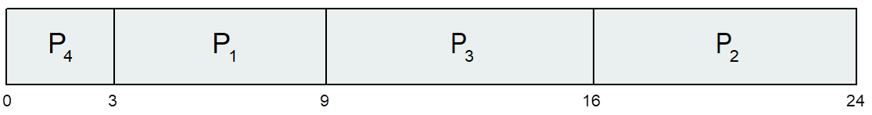
Example
ProcessArriv l Time Burst Time
P₁ 0.0 6
P₂ 2.0 8
P₃ 4.0 7
P₄ 5.0 3
SJF scheduling chart
Average waiting time = (3 + 16 + 9 + 0) / 4 = 7

Slide 12
Shortest Remaining Time First Scheduling
Preemptive version of SJN
Whenever a new process arrives in the ready queue, the decision on which process to schedule next is redone using the SJN algorithm.
Is SRT more “optimal” than SJN in terms of the minimum average waiting time for a given set of processes?

Slide 13
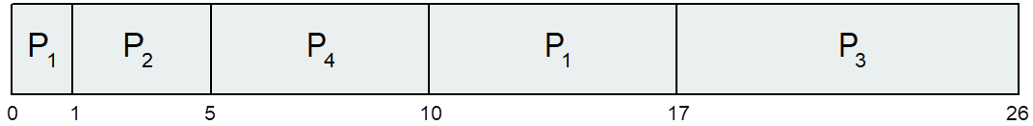
Example of Shortest-remaining-time-first
Now we add the concepts of varying arrival times and preemption to the analysis
ProcessA arri Arrival TimeT Burst Time
P₁ 0 8
P₂ 1 4
P₃ 2 9
P₄ 3 5
Preemptive SJF Gantt Chart
Average waiting time = [(10-1)+(1-1)+(17-2)+(5-3)]/4 = 26/4 = 6.5

Slide 14
Round Robin (RR)
Each process gets a small unit of CPU time (time quantum q), usually 10-100 milliseconds. After this time has elapsed, the process is preempted and added to the end of the ready queue.
If there are n processes in the ready queue and the time quantum is q, then each process gets 1/n of the CPU time in chunks of at most q time units at once. No process waits more than (n-1)q time units.
Timer interrupts every quantum to schedule next process

Slide 15
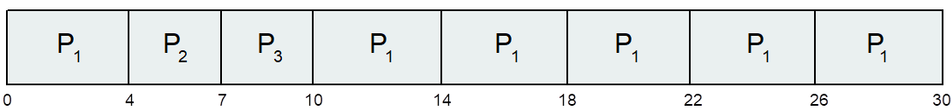
Example of RR with Time Quantum = 4
Process Burst Time
P₁ 24
P₂ 3
P₃ 3
The Gantt chart is:
Typically, higher average turnaround than SJF, but better response
q should be large compared to context switch time
•q usually 10 milliseconds to 100 milliseconds,
•Context switch < 10 microseconds

Slide 16
Priority Scheduling
A priority number (integer) is associated with each process
The CPU is allocated to the process with the highest priority (usually, smallest integer º highest priority)
Two schemes:
•Preemptive
•Nonpreemptive
Problem º Starvation – low priority processes may never execute
Solution º Aging – as time progresses increase the priority of the process
Note: SJF is priority scheduling where priority is the inverse of predicted next CPU burst time

Slide 17
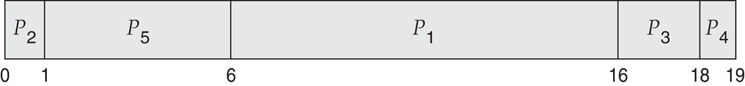
Example of Priority Scheduling
ProcessA arri Burst TimeT Priority
P₁ 10 3
P₂ 1 1
P₃ 2 4
P₄ 1 5
P₅ 5 2
Priority scheduling Gantt Chart
Average waiting time = 8.2

Slide 18
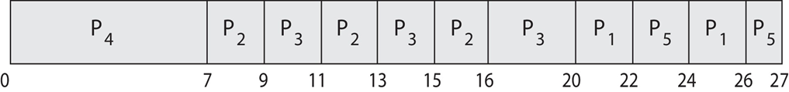
Priority Scheduling w/ Round-Robin
Run the process with the highest priority. Processes with the same priority run round-robin
Example:
Process a Burst Time Priority
P₁ 4 3
P₂ 5 2
P₃ 8 2
P₄ 7 1
P₅ 3 3
Gantt Chart with time quantum = 2

Slide 19
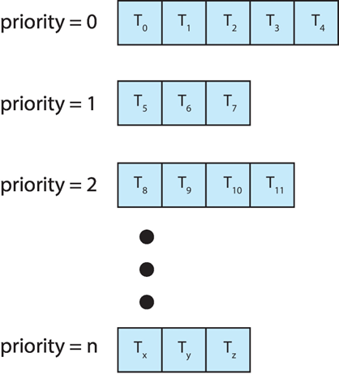
Multilevel Queue
The ready queue consists of multiple queues
•Priority scheduling, where each priority has its separate queue.
•Schedule the process in the highest-priority queue!

Slide 20
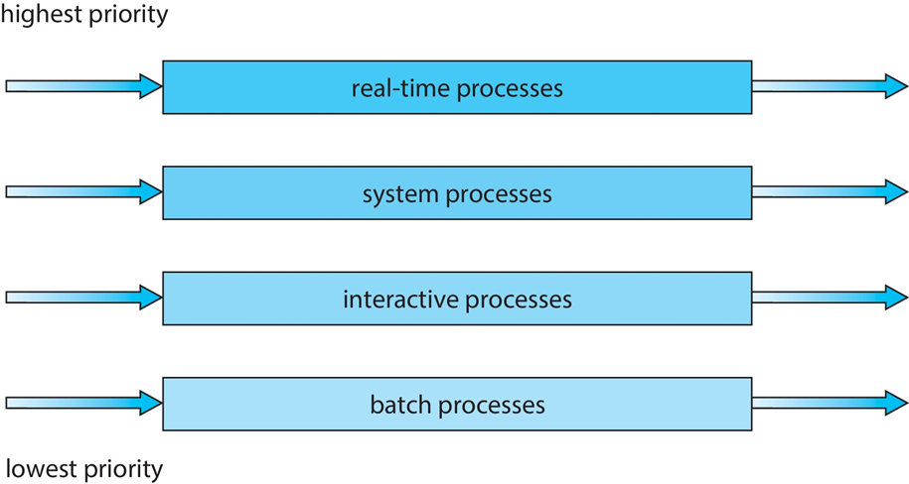
Multilevel Queue
Prioritization based upon process type

Slide 21
Multilevel Feedback Queue
A process can move between the various queues.
Multilevel-feedback-queue scheduler defined by the following parameters:
•Number of queues
•Scheduling algorithms for each queue
•Method used to determine when to upgrade a process
•Method used to determine when to demote a process
•Method used to determine which queue a process will enter when that process needs service
Aging can be implemented using multilevel feedback queue

Slide 22
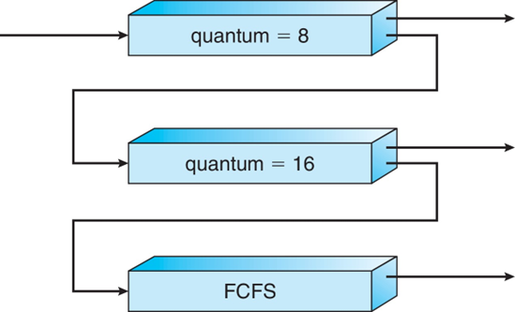
Example of Multilevel Feedback Queue
Three queues:
•Q₀ – RR with time quantum 8 milliseconds
•Q₁ – RR time quantum 16 milliseconds
•Q₂ – FCFS
Scheduling
•A new process enters queue Q₀ which is served in RR
When it gains CPU, the process receives 8 milliseconds
If it does not finish in 8 milliseconds, the process is moved to queue Q₁
•At Q₁ job is again served in RR and receives 16 additional milliseconds
If it still does not complete, it is preempted and moved to queue Q₂

Slide 23
Numerical Problems

Slide 24
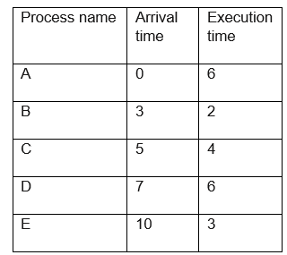
Ques 1 : Consider the following set of processes that need to be scheduled on a single CPU. All the time values are given in ms.
Using SRTF scheduling algorithm, the average process turnaround time (in ms) is____________

Slide 25
Ques. 2: Consider 3 processes A, B, C, to be scheduled as per SRTF algo. The Process 'A' is known to be scheduled first & when 'A' has been running for 7 units of time, then the process 'C’ has arrived. Then process 'B' has arrived and Completed running in 2 units time. Then what could be the minimum burst time of process A & C ?
a) 11 and 3 b) 11 and 4
c) 12 and 3 d) 12 and 4

Slide 26
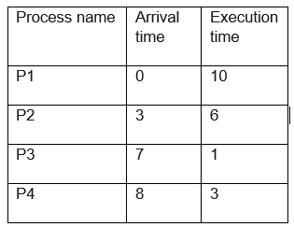
Ques. 3: Consider the following processes, with the arrival time and the length of the CPU burst given in milliseconds. The scheduling algorithm used is preemptive shortest remaining-time first.
The average turn around time of these processes is __________milliseconds

Slide 27
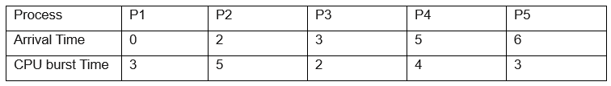
Ques. 4: Round Robin scheduler implemented a version with feedback queues. There are two Ready queues in the system. All new processes are placed in the higher priority Ready Queue and interrupted processes are placed in the lower priority ready queue. If there are any processes in the higher priority ready queue then first scheduled them by RR before scheduling lower priority ready queue processes. Consider the following processes with the arrival times and burst times
What is the average turn around time of all processes in the given system with time quantum of 2 units for the both ready queues?
(a) 10 (c) 7.3
(b) 8.2 (d) 9.8

Slide 28
Que .5 : Consider n processes sharing the cpu in round robin algorithm . The context switching time is ‘s’ units. Then what must be the time quantum q .Such that, the no. of context switches are reduced, but at the same time each process is guaranteed to get its turn/job at the cpu after ‘t’ seconds of time.
q= (t-ns)/n-1 c) q= (t-ns)/n+1
q= (t+ns)/n+1 d) q= (t+ns)/n-1

